Slide 1
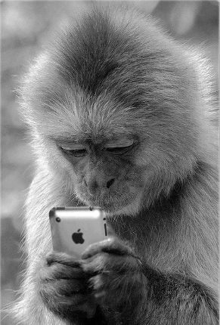

SwiftMonkey
Framework for generating randomised user input in iOS Apps
Nihal Alfred

Slide 2
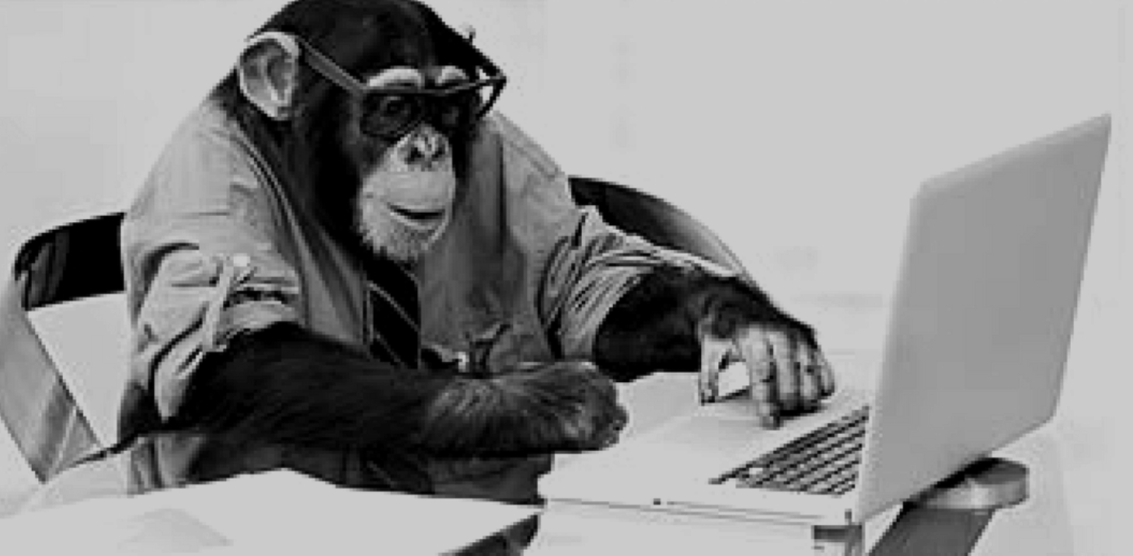
Monkey Testing?
A software testing technique
User tests the application by providing random inputs or trys to crash the application.
This technique does not follow any predefined test cases or strategy
Mostly works on tester’s mood and gut feeling.
Works very well when doing load/stress testing when you try to break your application by proving non-stop random inputs.
Monkey testing is all about “do what you want; automatically”.
Nihal Alfred

Slide 3
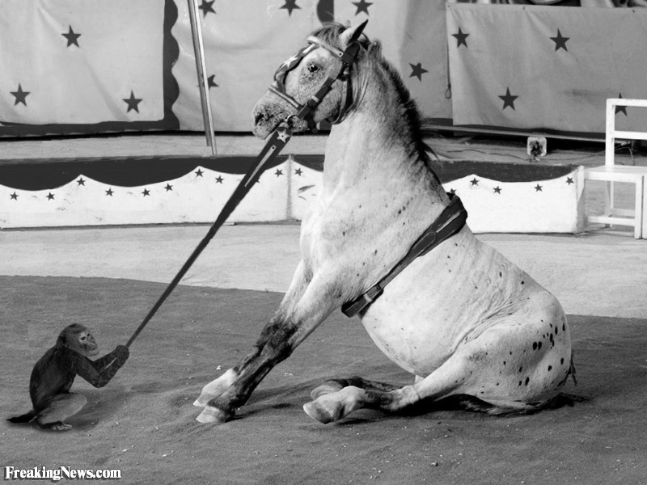
Monkey Vs Horse
Bridle :
Used to direct & control the horse
Helps the horse to keep focus and concentrate
Horse in testing:
Directed & driven by test cases/plans & strategies
Controlled by the quality metrics
Don’t want to divert our focus
Strictly concentrate on the set of test cases & obediently execute them.
It’s perfectly fine to be a horse, but sometimes don’t you enjoy being a Monkey?
Nihal Alfred

Slide 4
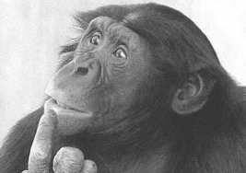
Why?
In UI testing, it's easy to think about how to test how things should work, but we struggle to figure out what kind of things might not work?
Ever showed your app to someone who proceeded to bang away at the screen & immediately crashed it by doing something you had never thought of?
Do you want to feel a bit more confident about your app's stability?
Do you have rare crashes that you just can't reproduce?
Do you have memory leaks that take a long time to manifest themselves, and require lots of UI actions?
Randomised testing will help you with all of these!
Nihal Alfred

Slide 5
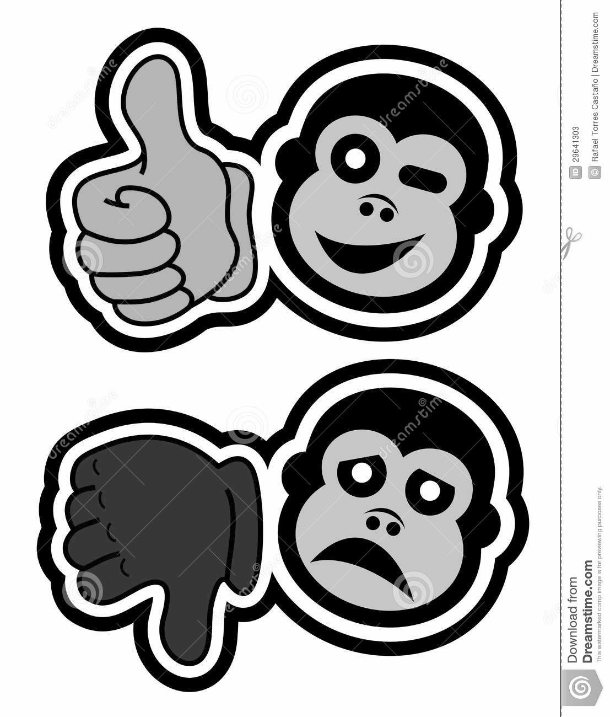
Advantages & Disadvantages
Can identify bugs which might have a higher impact
Can identify some out of box errors
Easy to set up and execute
Helps test the reliability of the software
Not costly
Number of bugs are less
Can go on for days till a bug is not discovered
Reproducing the bugs (if occurs) becomes a challenge
Some “not expected” output scenarios are difficult to analyse and is time consuming.
Nihal Alfred

Slide 6

Conclusion
Though chaotic, recommended to plan & assign time for it
Can discover some really good bugs: memory leaks or hardware crashing
Normally we ignore many cases thinking that “this scenario” will never happen, however if it happens, can lead to a serious impact (low priority & high severity bug)
“Horse” & “Monkey” testing together can contribute to achieve more quality & confidence in the software.
Nihal Alfred

Slide 7
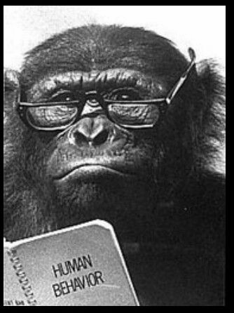
High level overview
Inspired by & has similar goals to UI AutoMonkey
Integrated into the Xcode UI testing framework, providing better opportunities to debug.
Add SwiftMonkey.framework to your UI test target.
Then add a test that creates a Monkey object and uses it to generate events.
Optionally, you also add the SwiftMonkeyPaws.framework to your main app, and create a MonkeyPaws object to enable visualisation. (This greatly increases the usefulness of your randomised testing, as you can see what touches caused any crash you may encounter)
Nihal Alfred

Slide 8
Demo
Nihal Alfred

